Slide 1
Sales analysis project
By Vansh Vij

Slide 2
THIS PROJECT IS ON SALES ANALYSIS OF PIZZAS AT PIZZAHUT.
HERE ARE THE EXCEL SHEETS WHICH ARE ANALYSED IN THIS PROJECT
https://drive.google.com/drive/folders/1C_8dAfSaqnDS32qJnWp9lKz-6_9Wbilv?usp=drive_link

Slide 3


TOTAL REVENUE GENERATED

Slide 4


HIGHEST PRICED PIZZA

Slide 5
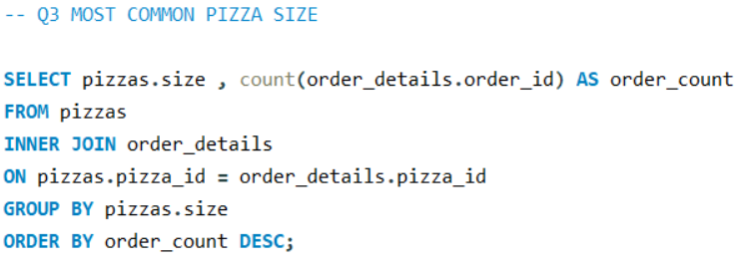
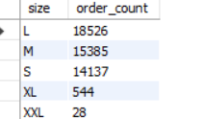

Slide 6
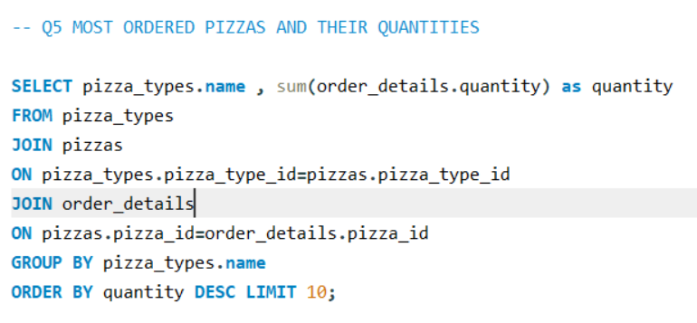
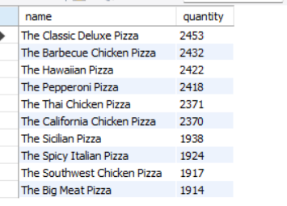

Slide 7

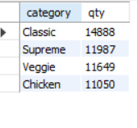

Slide 8

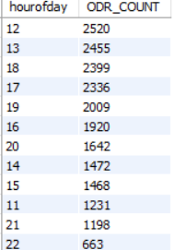

Slide 9

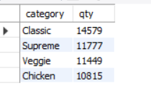

Slide 10

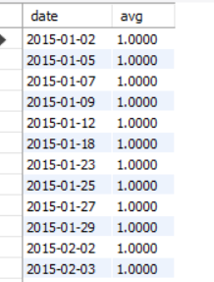

Slide 11

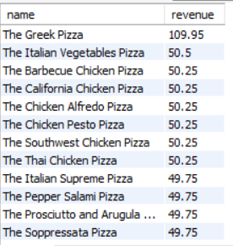

Slide 12
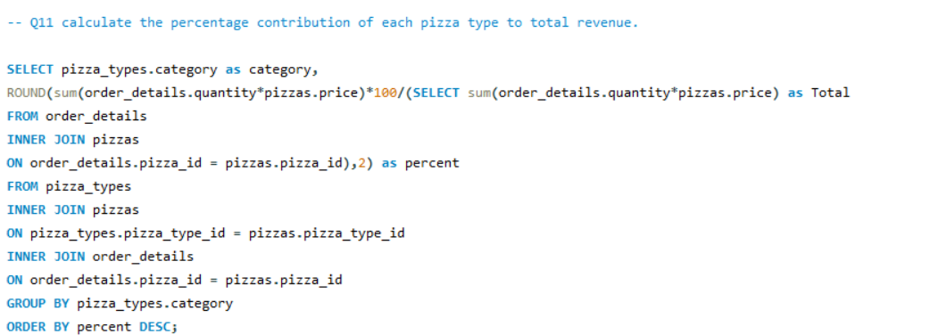
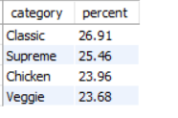

Slide 13
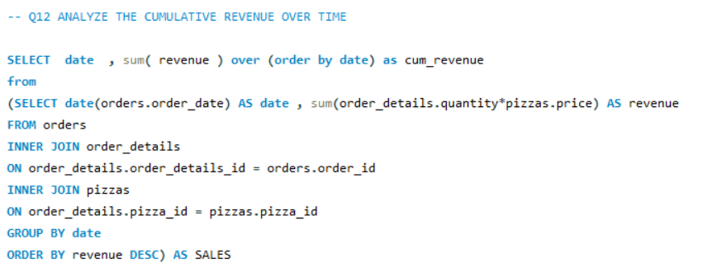
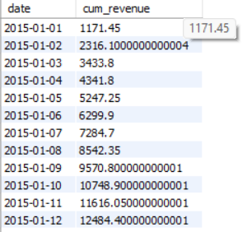

Slide 14
